Slide 1
Mechanisms and Robotics DE ES DM ZG561
Lecture-1
Dr. Glynn John S
Mechanical Engineering Department

Slide 2
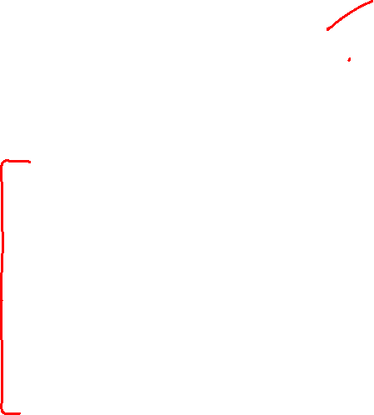
Module 1. Fundamentals of Robot Technology
Introduction
Automation and Robotics
Robotics in Science Fiction
Progressive Advancement
The Robotics trends and the future prospects
Robot Anatomy
Links, Joints and Joint Notation scheme
Degrees of Freedom (DOF)
Required DOF in a Manipulator
Arm Configuration
Wrist Configuration
The End-Effector (EE)
Human arm characteristics

Slide 3
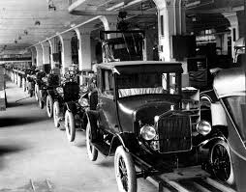

Introduction to Automation
Mass production assembly lines were introduced in 1905 by Ford Motor Company.
Specialized machines were designed to manufacture for high volume production of mechanical and electrical parts.
When a production cycle ends and new models of parts are introduced, production machines have to be shut down and the hardware retooled.
Since periodic modification of the production hardware is required, this type of automation is called Hard Automation.
When programmable mechanical systems are used to perform manufacturing tasks, new components can be made just by changing the program in the machine, This type of automation is called Soft Automation.

Slide 4
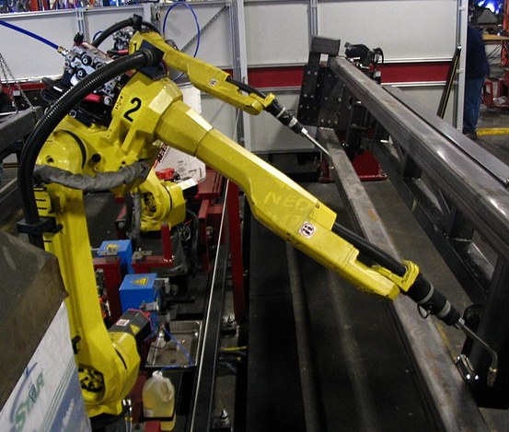
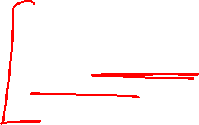
Introduction to Automation
Flexible automation is an extension of programmable automation.
The disadvantage with programmable automation is the time required to reprogram and change over the production equipment for each batch of new product.
This is lost production time, which is expensive. In flexible automation, the variety of products is sufficiently limited so that the changeover of the equipment can be done very quickly and automatically.
The reprogramming of the equipment in flexible automation is done off-line; that is, the programming is accomplished at a computer terminal without using the production equipment itself.
Flexible automation systems allow for adjustments to be made for product or process changes.
Types of flexible automation systems include multi-purpose CNC machines and industrial robots.

Slide 5
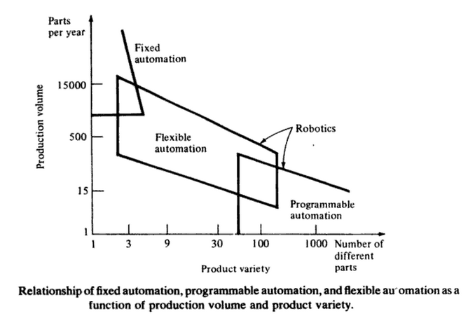
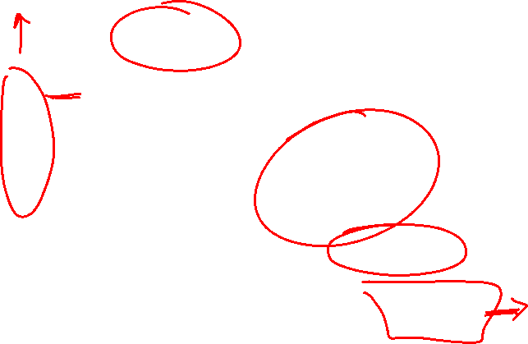
Introduction

Slide 6
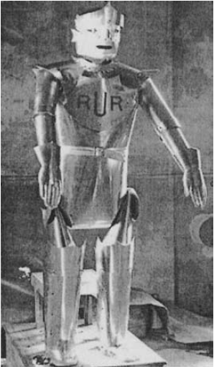

Use of the word Robot
The word ''robot comes from the Czech word ''robota'' which means forced labor.
It was first used in 1921 by the novelist Karel Capek in his novel ''Rossum‘s Universal Robots".
The fantasy associated with robotics offered by science fiction movies, and printed and animated cartoons is so far from reality that actual industrial robots seem primitive.
A robot from Karel Capek's novel ''Rossum 's Universal Robots
Source: INDUSTRIAL ROBOTS PROGRAMMING, J. Norberto Pires

Slide 7
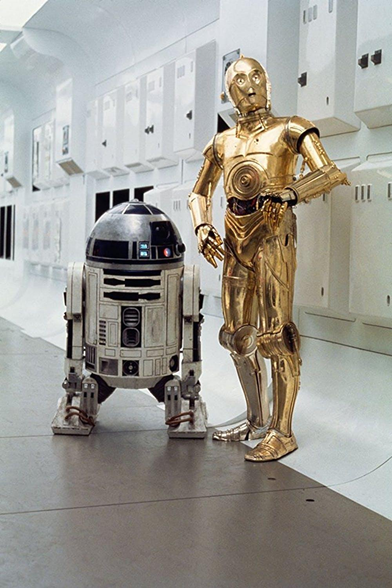
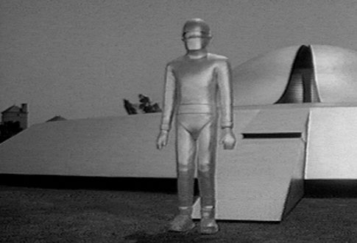
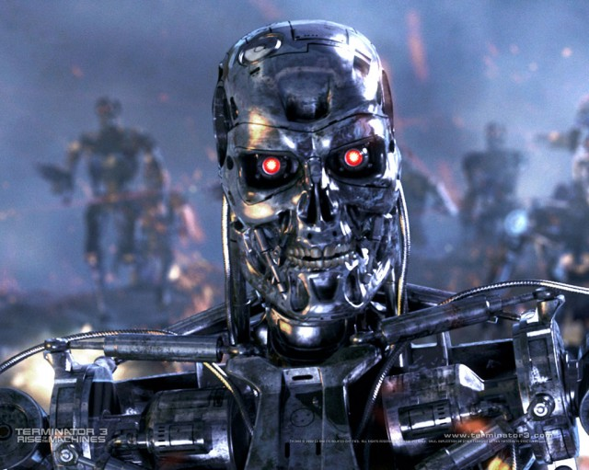
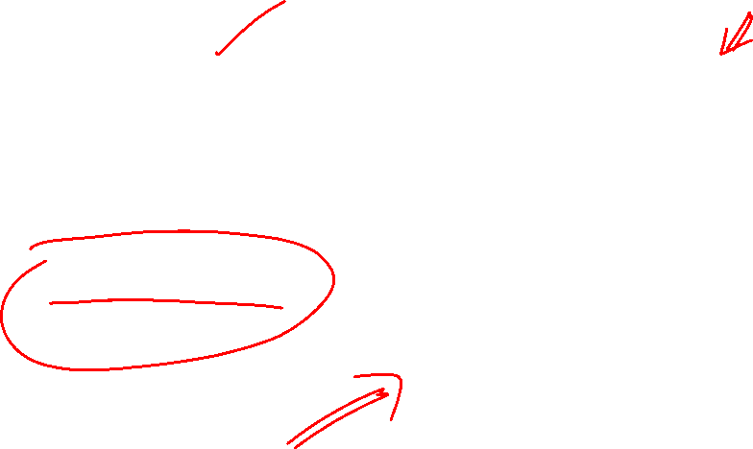
Robotics in Science Fiction
Gort from the movie The day the earth stood still.
Robot in The Terminator
Source: www.jeffbots.com
C-3PO and R2-D2 Robots
from Star wars
Source: www.smithsonianmag.com

Slide 8
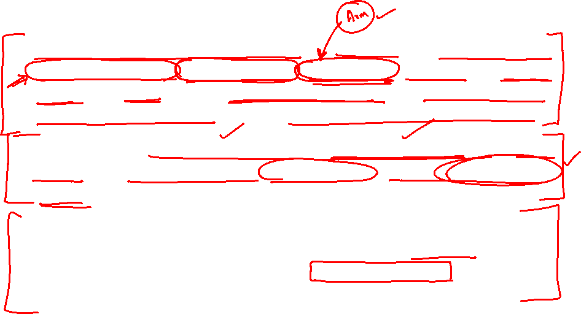
Automation and Robotics
Robotics Institute of America defines a robot as a “reprogrammable multifunctional manipulator designed to move material, parts or specialized devices through variable programmable motions for the performance of a variety of tasks”.
A Robot is a software-controllable mechanical device that uses sensors to guide or more end-effectors through programmed motions in a workspace in order to manipulate physical objects.
Contrary to popular notions about robots in science fiction literature, today’s industrial robots are not Androids built to impersonate humans but most are anthropomorphic in the sense they are patterned after the human arm.

Slide 9
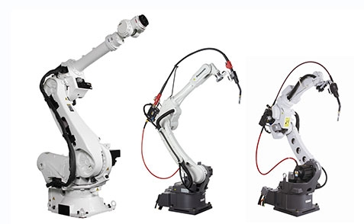
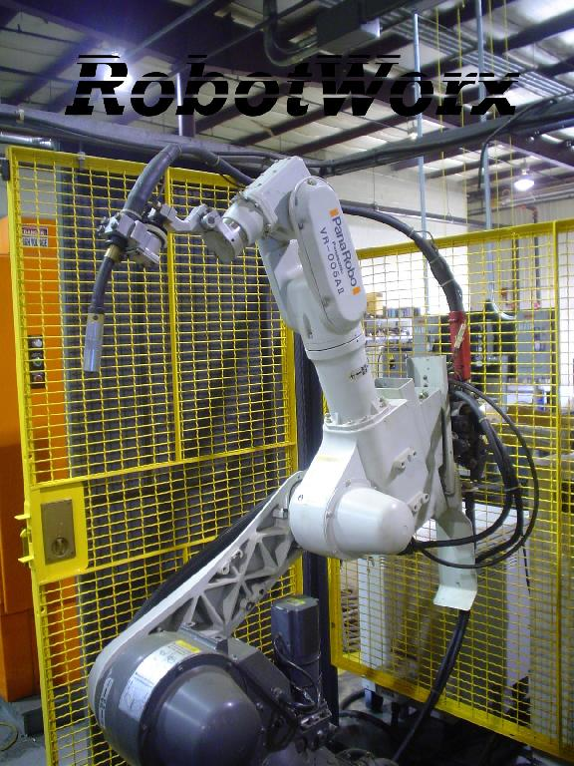
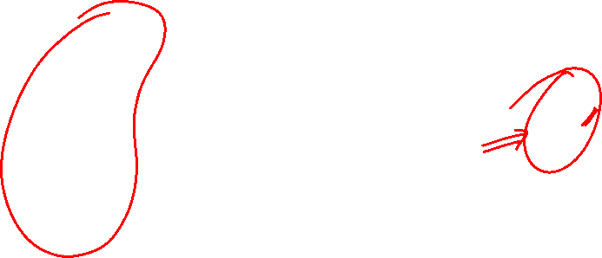
Industrial Robots
Material handling,
plasma cutting,
spot welding, and
resistance welding
The slim design of the Panasonic VR-5 AII robot makes it the perfect solution for compact work areas. This robot model is typically outfitted for MIG welding or material handling tasks.
are all done with ease by the six axis Panasonic VR-120HII.
This high performance robot is controlled by the easy to use Panasonic robot controller.

Slide 10
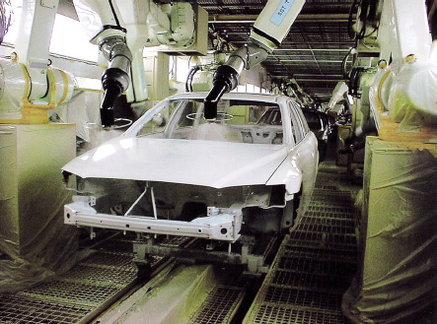
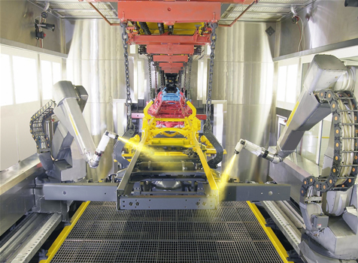
Industrial Applications
Robots Performing Spray Painting

Slide 11
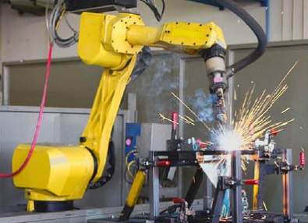
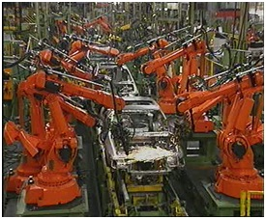
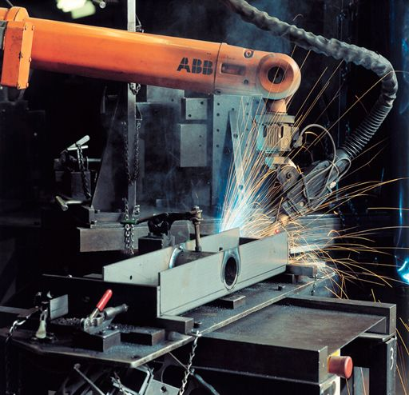
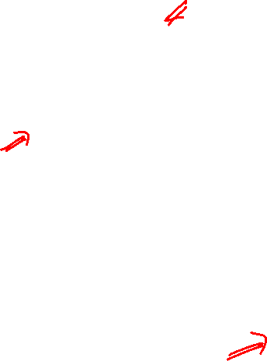
Industrial Applications
Robots Performing Arc Welding

Slide 12
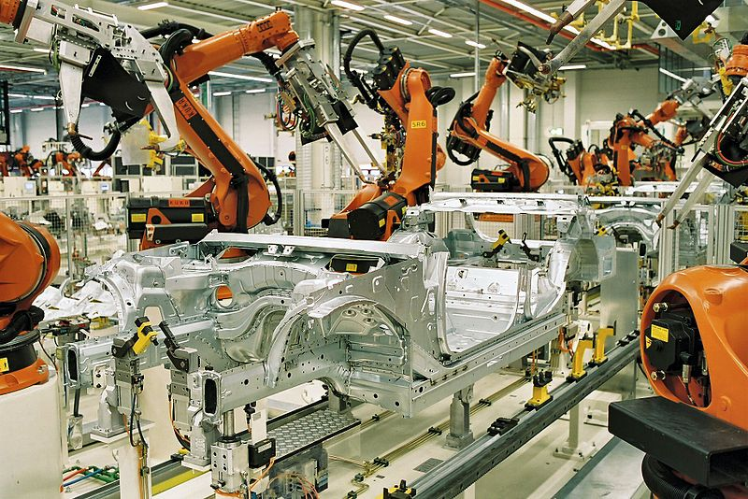
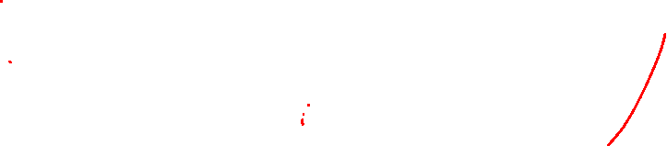
Industrial Applications
Spot Welding Robots

Slide 13
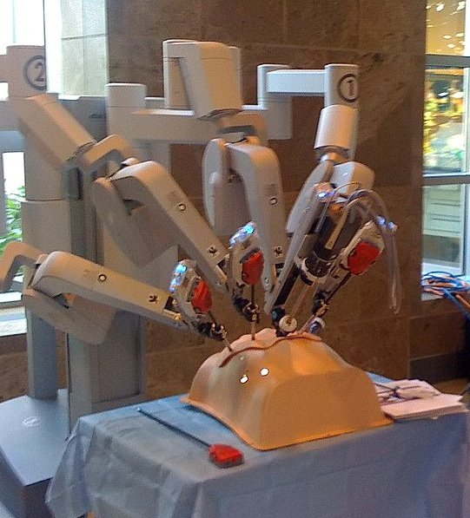
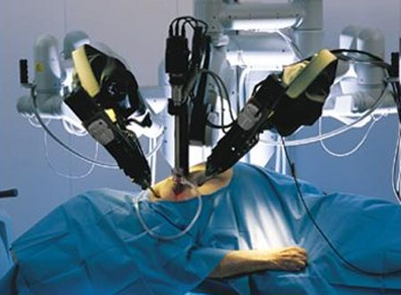
Medical Applications
Robotic system called Da Vinci, used for heart surgery, programmed to follow the surgeon’s hand movements accurately without any tremors.
Medical Robot
Robot Performing Surgery

Slide 14
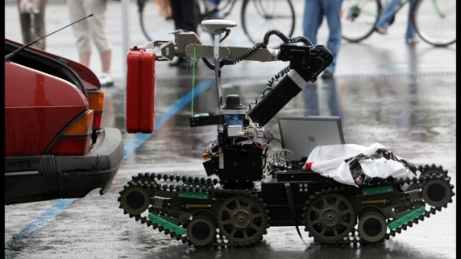
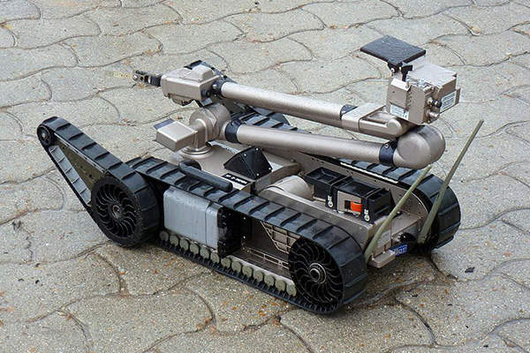
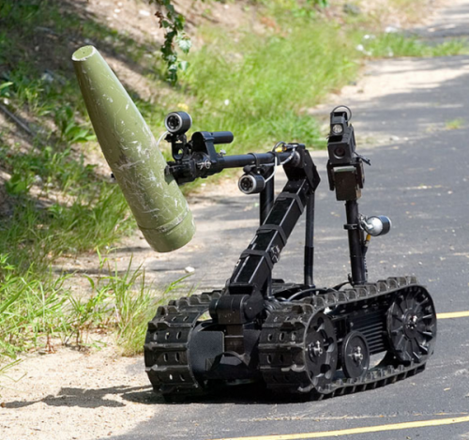

Search and Rescue Applications
A robot picking a suitcase from a car
Image Source: https://newatlas.com/
Pacbot – A Robot for military applications
Source: www.army-technology.com
A robot used for disposing explosive ordnance
https://www.qinetiq.com

Slide 15
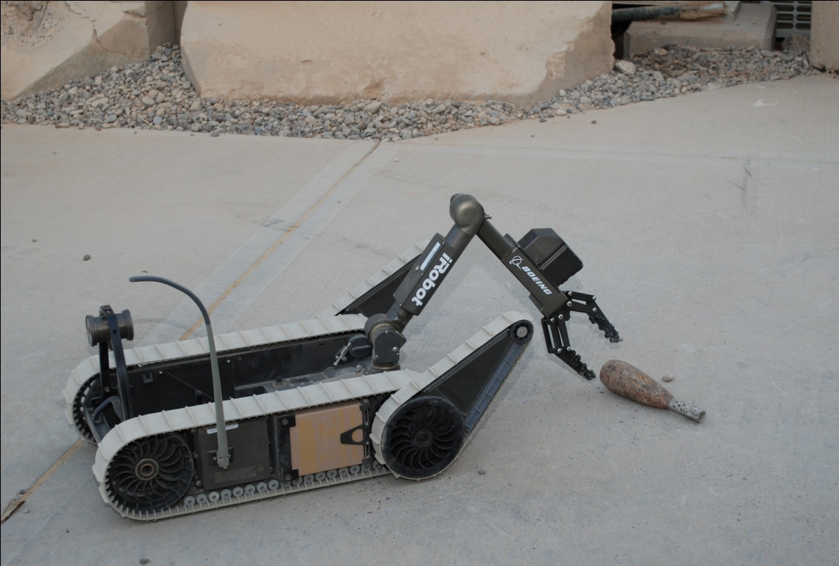
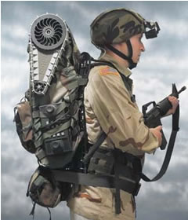
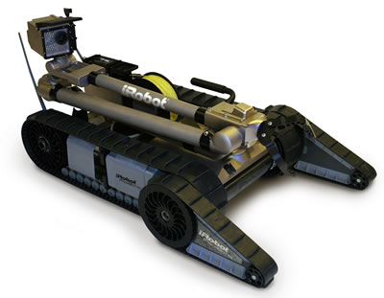

Search and Rescue Applications

Slide 16
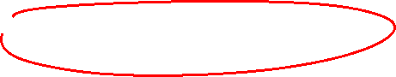

Industrial Robot - History
The Unimate was the very first industrial robot.
Conceived from a design of a mechanical arm patented in 1954 (granted in 1961) by American inventor George Devol
The Unimate was developed as a result of the foresight and business acumen of Joseph Engelberger - the Father of Robotics.
In 1961 Engelberger established Unimation, Inc., company in Danbury, Connecticut, to develop the business in the newly established robotics industry he created.

Slide 17
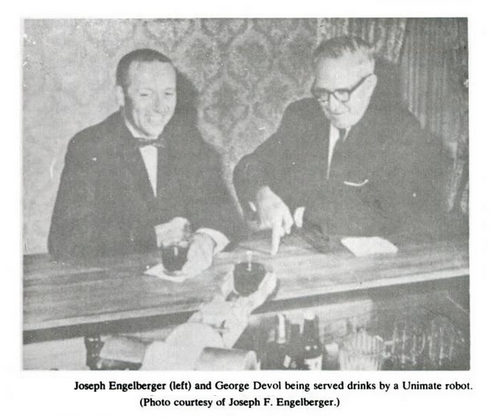
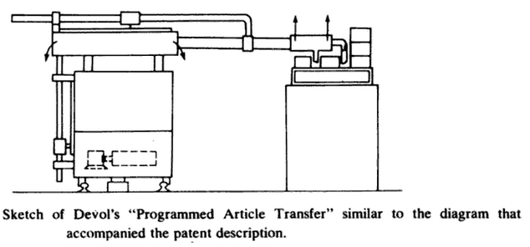
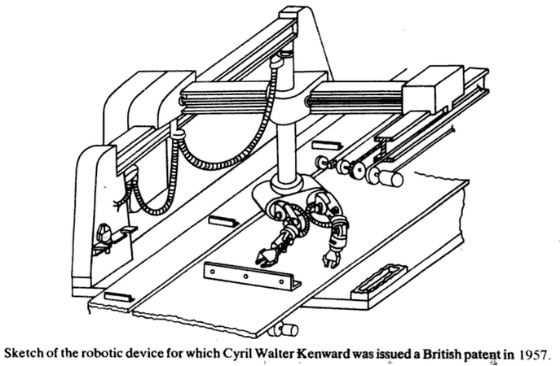
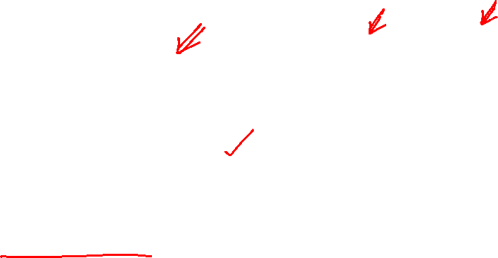
Industrial Robot - History
Source: Industrial Robotics by Mikell P. Groover

Slide 18
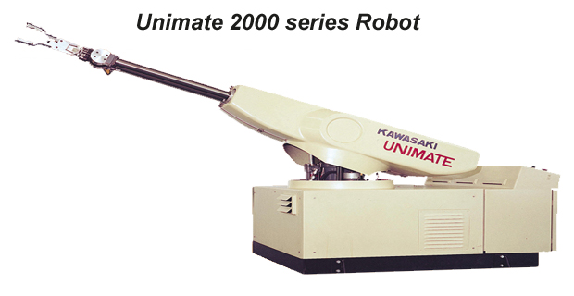
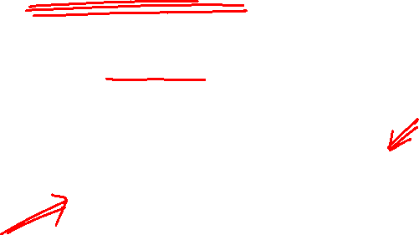
Industrial Robot - History
First industrial Robot produced by Unimation was installed in General Motors, USA in 1961.

Slide 19
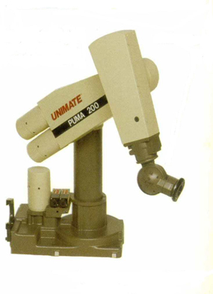
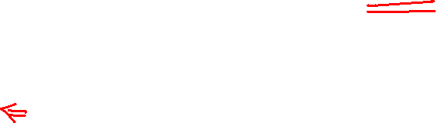
Industrial Robot - History
Unimation also manufactured Programmable Universal Machine for Assembly (PUMA robot).

Slide 20
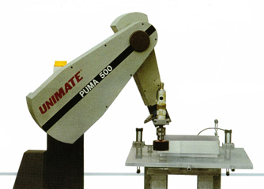

Industrial Robot - History
A compact and computer-controlled robot for
high speed,
close-tolerance assembly,
light materials handling, and
inspection applications.

Slide 21
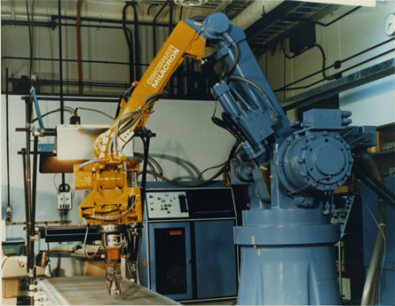
Industrial Robot
The Tomorrow Tool (T³ robot) manufactured by Cincinnati Milacron Inc. (shown in figure).
T³ robot is an articulated six axis robot.
CINCINNATI MILACRON T3-776

Slide 22
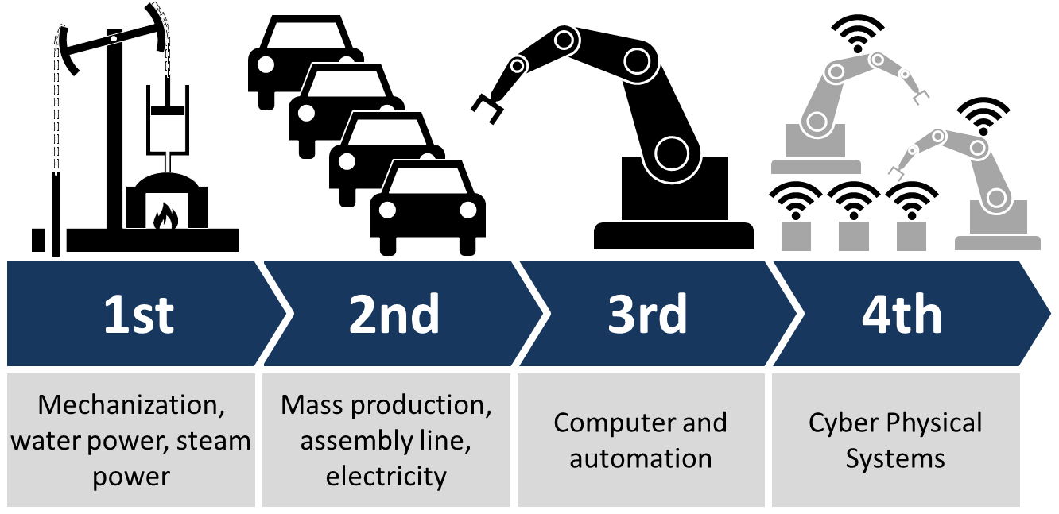
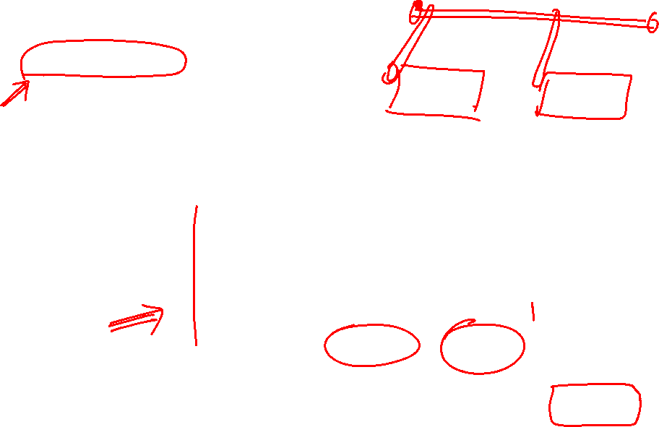
The Robotics trends and the future prospects
Industry 4.0 is a name given to the current trend of automation and data exchange in manufacturing technologies. It includes cyber-physical systems, the Internet of things, cloud computing and cognitive computing. Industry 4.0 is commonly referred to as the fourth industrial revolution

Slide 23
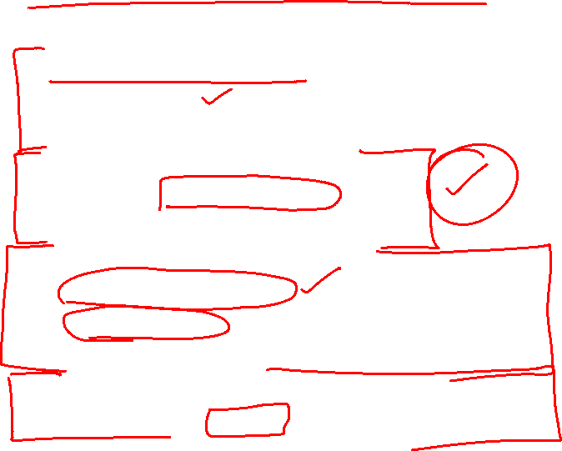
Progressive Advancement
First Generation Robots
Repeating
Non-servo, Pick and Place
Second Generation Robots
Use of Sensing devices
Response to sensory feedback
Third Generation Robots
Artificial intelligence
Self learning
Conclusion drawing from past experiences
Fourth Generation Robots
May be an android or a biological robot.

Slide 24
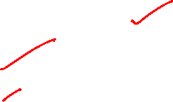
The Robotics trends and the future prospects
Public Security / Military
Healthcare
Coworkers
Robots at Home
Robots in Education
Entertainment

Slide 25
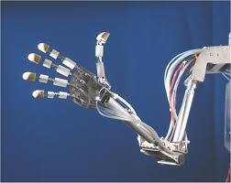
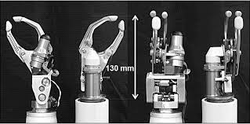
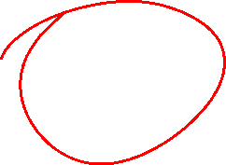
The Robotics trends and the future prospects
Complex mechanical hands with fingers attached to a robot.

Slide 26
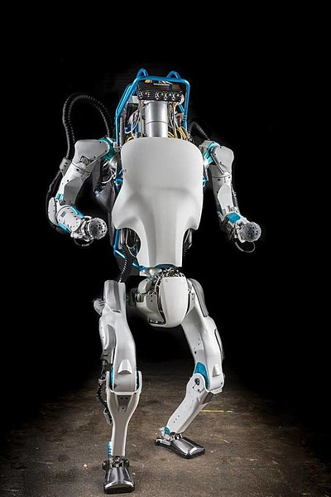



The Robotics trends and the future prospects
Humanoid robot ASIMO from Honda
Atlas from Boston Dynamics

Slide 27


Coordinate Systems
Cartesian

Slide 28


Coordinate Systems
Cylindrical

Slide 29


Coordinate Systems
Spherical

Slide 30





Robot Anatomy
Arm
Study of the physical construction of a Robot.
The Manipulator consists of Rigid links and Joints.
A Joint provides relative motion between two links.
Wrist
Shoulder
Elbow
Manipulator
Wrist
Elbow
Shoulder
or
Base
Hand
End Effector

Slide 31


Slide 32

Mechanism Basics
Mechanisms consist of connected parts with the objective of transferring motion and force from a power source to an output.
One part is designated the frame because it serves as the frame of reference for the motion of all other parts. The frame is typically a part that exhibits no motion.
Links are the individual parts of the mechanism. They are considered rigid bodies and are connected with other links to transmit motion and forces

Slide 34


Slide 35



Degrees of Freedom
Degrees of freedom is often used to describe the number of directions that a robot can pivot or move a joint.

Slide 37

Links, Joints and Joint Notation Scheme
Types of Robot Joints
Type | Notation | Symbol | Description
Revolute | R |  | Rotary motion about an axis
Linear (Prismatic) | L |  | Linear motion along an axis

Slide 38



Joints
Links in a mechanism are connected using joints.
The joints can be of the following types
Pin Joint
Sliding Joint (Prismatic Joint)
Source: Machines and Mechanisms, Applied Kinematic Analysis (Fourth Edition) – David H. Myszka

Slide 39

Types of Robot Joints
Pin Joint
(Revolute)

Slide 40
THANK YOU
The presenter is grateful to the authors of the following textbooks.
Machines and Mechanisms, Applied Kinematic Analysis (Fourth Edition) – David H. Myszka
Industrial Robotics - Mikell P. Groover
Fundamentals of Robotics – Robert Schilling

